Slide 1
A Major development GREATLY impacting insurance IN THE NEXT DECADE
Presented by
Morgan Maurice Jordan-Ferguson

Slide 2
Focus: The US’ contribution to inflation in insurance
Introduction
The Challenges
The Solution
Limitations
References
Notes:
I’ve chose to focus on the US as they are the biggest customer of insurance

Slide 3
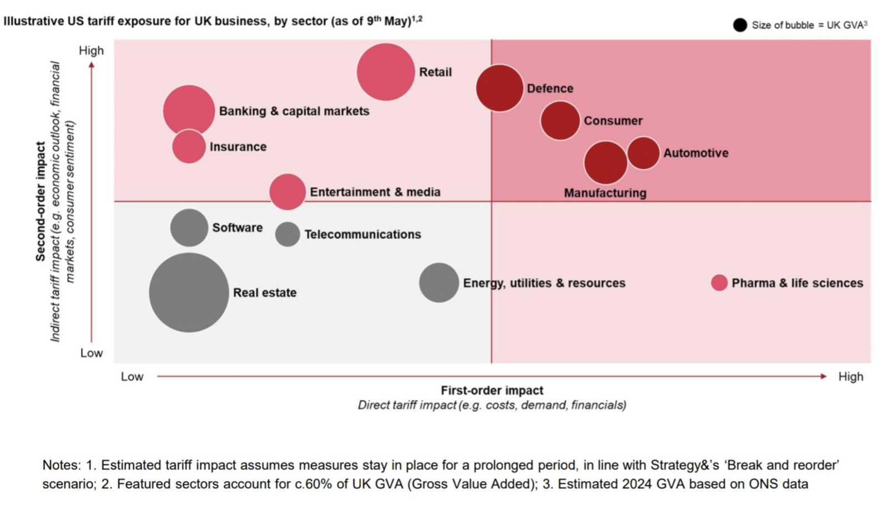
Introduction
I believe the US’s withdrawal from global leadership in trade will greatly impact the next decade of insurance.
Replacing a predictable, western dominated trade system with a volatile multipolar system.
Thus, resetting relations between nations and working towards multilateralism.
The resulting fragmentation caused by the US’ withdrawal position is a sign of great risk for insurers because US tariffs have caused the cost of imports to rise, leading to subsequent increase in building material costs, manufacturing costs, energy costs as seen in the graph a rise that many insurers’ premiums may not account for, forcing the insurance industry to rely on reactive risk transfer (paying for losses) less and to lean proactive strategic resilience (modelling geopolitical fragmentation as a core business cost).
Notes:
I believe the US’s withdrawal from global leadership in trade will greatly impact the next decade of insurance. Replacing a predictable, western dominated trade system with a volatile multipolar system. We have seen tariffs erode trade with their partners: spiking inflation, devaluing their currency, and pushing allies to seek certainty in alternative partners. Thus, resetting relations and working towards multilateralism.
The resulting fragmentation caused by the US’ withdrawal position is a sign of great risk for insurers because US tariffs have caused the cost of imports to rise, leading to subsequent increase in building material costs, manufacturing costs, energy costs as seen in the graph a rise that many insurers’ premiums may not account for, forcing the insurance industry to rely on reactive risk transfer (paying for losses) less and to lean proactive strategic resilience (modelling geopolitical fragmentation as a core business cost).

Slide 4
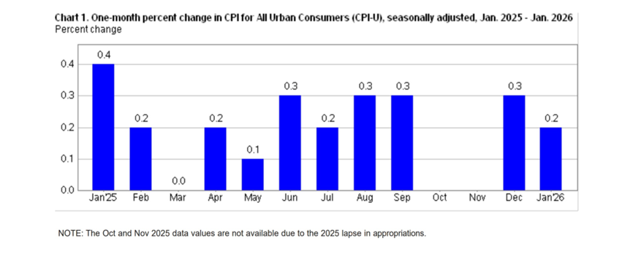
The Challenges
Primary Consequences:
Reserve deterioration
Exacerbated by extreme verdicts and unstable liability severity trends.
Forces insurers to top up old reserves, creating significant model risk and capital strain for long-tail casualty lines.
Fragmented Landscapes
The intersection of global instability and trade wars creates significantly less efficient supply chains.
As the US retreats from its role as a stable source of certainty, insurers must adapt to diverse jurisdictional rules for trade, carbon emissions, and insurance requirements that change at every border.
Introducing structural inefficiencies, such as the double squeeze where weakening local currencies drive up the costs of imported repair materials and USD denominated reinsurance.
The US’ isolation is a source of great uncertainty for its allies and the uncertainty in US market (the largest market for insurance) around their tariff policy has spread to all its trading partners.
With new regional partners, insurers can no longer assume alignment with established US frameworks. Navigating these 'regulatory islands' without sufficient historical data precludes a traditional reactive approach, creating significant model risk beyond reactive risk transfer toward a model of proactive strategic resilience to protect overall solvency.
Inflation (which spiked with tariff announcements 2025) can be seen in chart 1, creating a few critical challenges for the insurance industry, including: claims inflation, higher retrocession costs, and uncertain loss development triangles which correlate to announcements of any tariffs in 2025
Notes:
Primary Consequences:
Reserve deterioration, occurring when funds originally set aside for future claims prove insufficient due to rising construction and medical costs. In the US especially, this is exacerbated by extreme verdicts and unstable liability severity trends that outpace standard economic inflation. This forces insurers to divert current capital to top up old reserves, creating significant model risk and capital strain for long-tail casualty lines.
The intersection of global instability and trade wars has forced insurance companies to navigate a fragmented landscape where "regulatory islands" replace unified global standards, creating significantly less efficient supply chains. As the US retreats from its role as a stable source of certainty, insurers must adapt to diverse jurisdictional rules for trade, carbon emissions, and insurance requirements that change at every border. This shifting environment introduces structural inefficiencies, such as the double squeeze where weakening local currencies drive up the costs of imported repair materials and USD denominated reinsurance.

Slide 5
The Solution
Mitigating Inflationary & Reserve Volatility
To stabilize capital against the double squeeze of rising costs and currency devaluation, insurers can utilize:
Dynamic Indexing & Predictive Modeling
Structured Retrocession
Adapting to "Regulatory Islands" & Trade Fragmentation
As supply chains become less efficient, the solution lies in ensuring the ability to operate across borders:
Localised Jurisdictional Frameworks
Strategic Trade Corridor Hedging
Notes:
Dynamic Indexing & Predictive Modeling: Use AI-driven analytics to identify shifts in loss development triangles early, allowing for incremental premium adjustments that prevent massive "catch-up" reserve shocks.
Structured Retrocession: Locking in multi-year reinsurance costs to hedge against the volatility of the "hard market" and ensure long-term solvency.
Localised Jurisdictional Frameworks: Developing bespoke compliance and insurance programs that adapt to specific regional rules for carbon, trade, and labor, rather than relying on a failing "one-size-fits-all" global policy.
Leveraging new regional certainties—such as the Canada-China trade deal to diversify risk away from US-centric volatility and diversify export portfolios for agricultural and industrial clients.

Slide 6
Limitations
​Inaccurate Predictive Modeling
High Operational Complexity
​Capital Availability in Hard Markets
Real-term Value Loss
Ambiguity in War and Sanctions
Notes:
​Inaccurate Predictive Modeling: AI-driven early warning systems are only as good as the historical data they ingest; sudden, unprecedented "imported" inflationary shocks are difficult to quantify and may still bypass even the most advanced regulatory frameworks.​
High Operational Complexity: Navigating "regulatory islands" creates a heavy operational and capital burden, as insurers must maintain specialized compliance teams for every jurisdiction rather than utilizing efficient global standards
​Capital Availability in Hard Markets: While sidecars and alternative capital provide a buffer, these sources of funding often dry up or become prohibitively expensive during the very periods of global instability they are meant to solve for.​
Real-term Value Loss: Despite hedging strategies, when reserves are held in local currencies while tracking USD-linked inflation, firms face a real-term loss of reserve value that can threaten overall solvency regardless of strategic positioning.​
Ambiguity in War and Sanctions: As seen in the Ukraine conflict, global instability leads to ambiguity in war exclusions and protracted reinsurance disputes, making it difficult to guarantee payouts for "proactive" supply chain products. (Link to tariffs, us hostility, greenland)

Slide 7
References
A WNS Perspective (2025). Insurance and Tariffs: Modeling the Unpredictable in an Era of Global Uncertainty. [online] Wns.com. Available at: https://www.wns.com/perspectives/blogs/insurance-and-tariffs-modeling-the-unpredictable-in-an-era-of-global-uncertainty [Accessed 26 Feb. 2026].
Bremmer, I. (2025). What happens when no one’s in charge. [online] GZERO Media. Available at: https://www.gzeromedia.com/by-ian-bremmer/what-happens-when-no-ones-in-charge [Accessed 25 Feb. 2026].
Global trade redefined: Insurance Dealing with tariff uncertainty. (2025).
Johnson, D., Maaa, A., Koch, T. and Miller (2025). Managing through economic uncertainty: 1 How to handle foreign currency volatility for (re)insurers Managing through economic uncertainty: How to handle foreign currency volatility for (re)insurers Introduction to foreign exchange (FX) impacts in insurance.
Keir Starmer lands in Beijing and says China trip ‘will bring benefits back to UK’. (n.d.). BBC News. [online] Available at: https://www.bbc.co.uk/news/live/cly9p5kr2q7t.
Lowell, M. (2026). EU-Mercosur: Key developments shaping the trade agreement. [online] Trade Compliance Resource Hub. Available at: https://www.tradecomplianceresourcehub.com/2026/02/18/eu-mercosur-key-developments-shaping-the-trade-agreement/ [Accessed 25 Feb. 2026].
World History. (2025). The History of Insurance Industry: a complete guide - World History. [online] Available at: https://worldhistoryjournal.com/2025/03/09/the-history-of-insurance-industry/.
www.bing.com. (2022). Microsoft - Search. [online] Available at: https://www.bing.com/ck/a?.
www.guycarp.com. (n.d.). Managing Reserve Risk. [online] Available at: https://www.guycarp.com/insights/2014/10/managing-reserve-risk.html.
Yousif, N. (2026). Canada’s deal with China signals it is serious about shift from US. BBC News. [online] 16 Jan. Available at: https://www.bbc.co.uk/news/articles/cm24k6kk1rko.

